Slide 1

Machine Learning Building Blocks
Basic template
Unique specifications per Block (Different Algorithms)

Slide 2
Machine learning algorithms
Linear regression ( >= 1 predictor variable)
Decision trees (1 predictor variable)
Support vector machines (SVMs)
K-nearest neighbors (KNN)
Neural networks
Deep learning
Random forests
Clustering

Slide 3

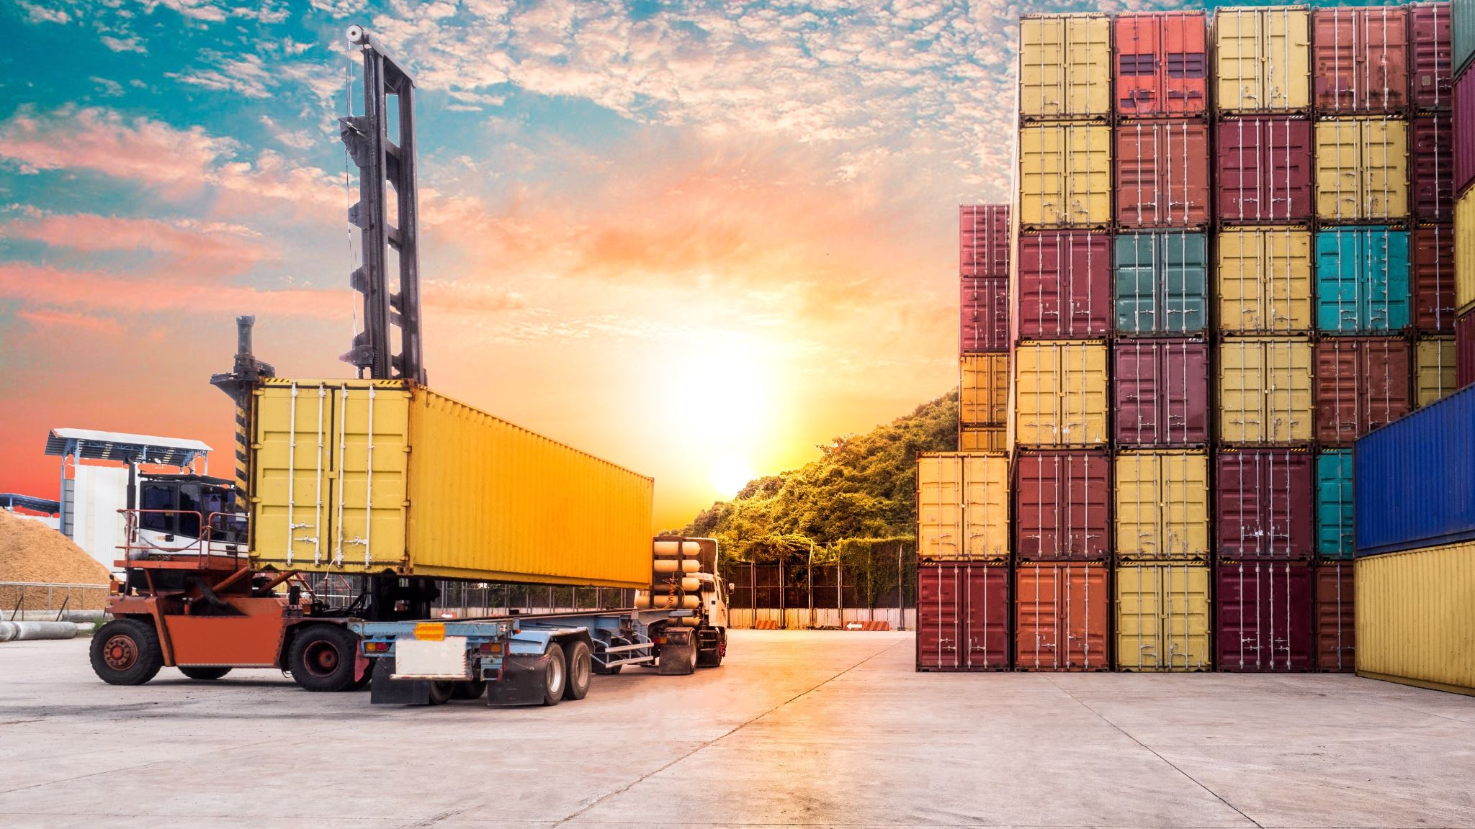
Docker
One ML Block per one docker container

Slide 4
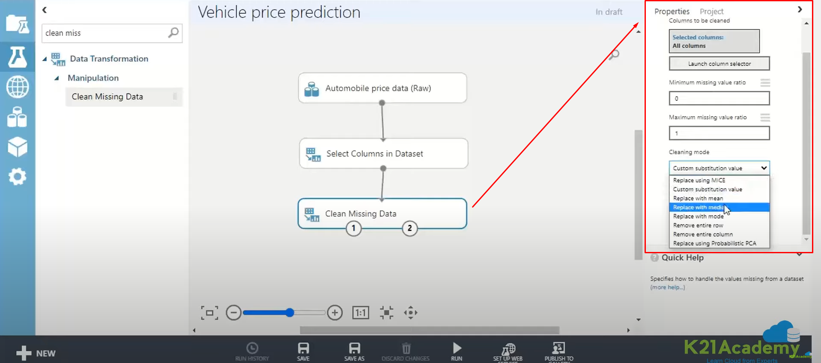
Building blocks properties
Specific individual configuration for different blocks
Arrows only used for connecting blocks, nothing more.
Validation logic on an individual block

Slide 5
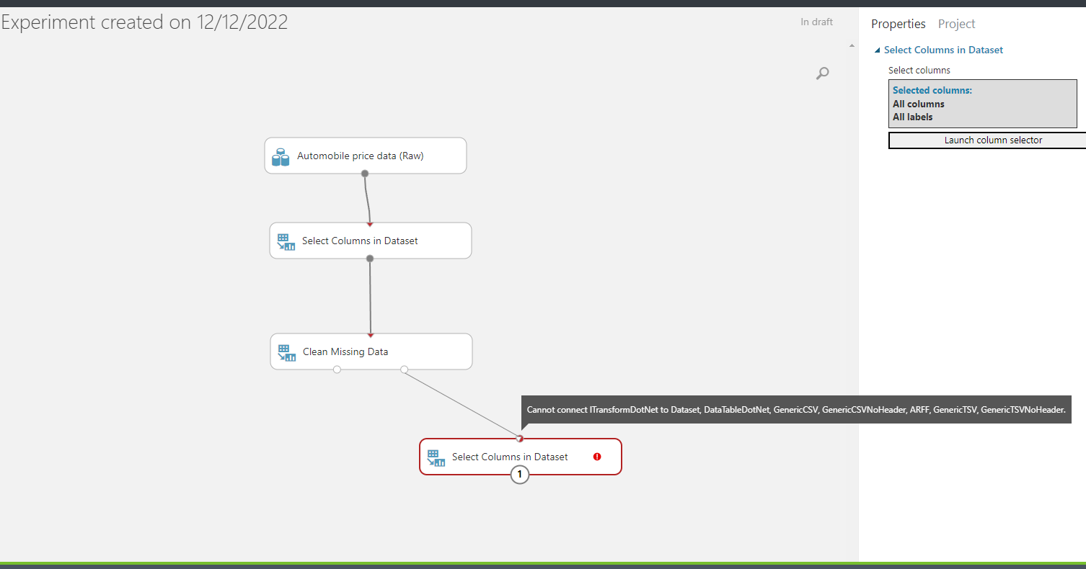
Blocks multiple connection options
A block may have two outputs
Ouput one – cleaned dataset
Output two – cleaning transformation

Slide 6

How to connect Django with apache spark Option 1
Apache spark application web server
Django web application
Gunicorn (run Django and connect to Spark app via WSGI protocol)

Slide 7
How to connect Django with apache spark Option 2
Use Spark’s built-in web server (SparkUI)

Slide 8
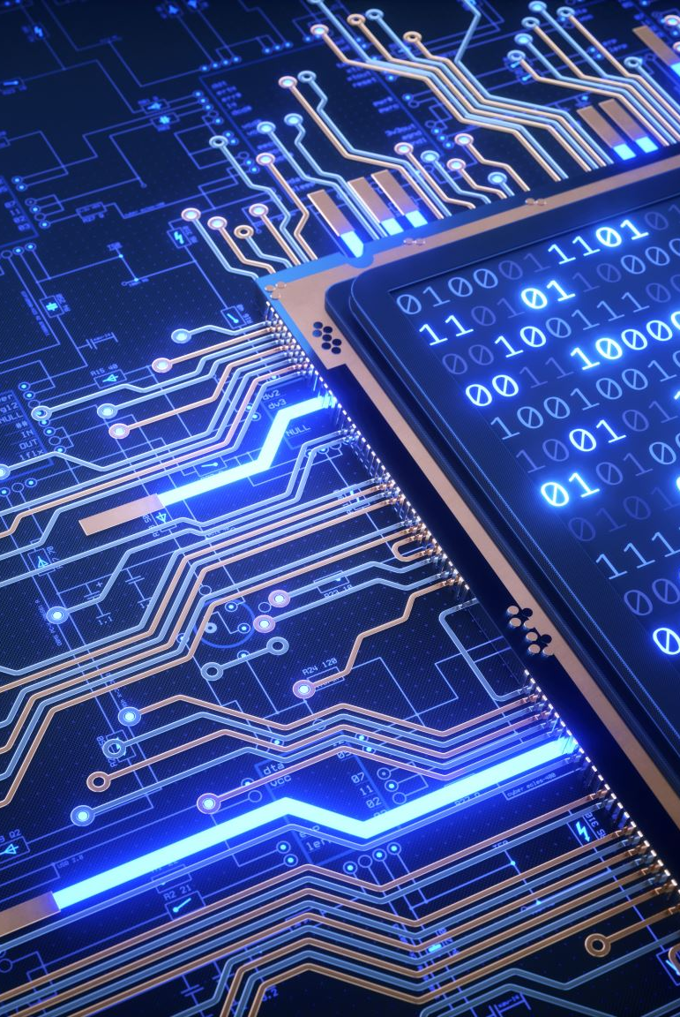
How to run apache spark?
Requirements: Java, Apache Spark installed on the system
Run via terminal

